Slide 1
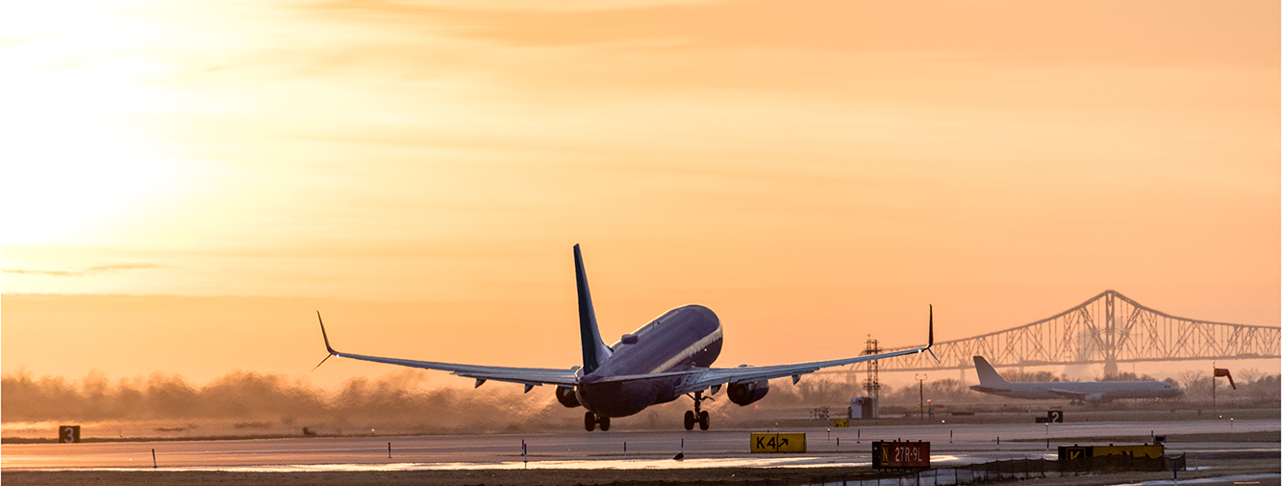
DBE 2026 - 2028 Goal Setting
Stakeholder Consultation Meeting
July 22, 2025
Office of Business Diversity

Slide 2
Agenda
Overview of PHL’s Office of Business Diversity
DBE Program Basics
PHL Goal Setting Methodology
How to Provide Comments
Questions

Slide 3

PHL’s Office of Business Diversity
Disadvantaged Business Enterprise (DBE)
Sets overall Airport goals on FAA-funded contracts
Submits goals and plans to FAA
Sets contract goals
Monitors
Airport Concession Disadvantaged Business Enterprise (ACDBE)
Sets overall Airport goals on FAA-funded concessions
Submits goals and plans to FAA
Sets concessions goals
Monitors
DBE &
DBE Certification
Services
One of five certifying agencies in Pennsylvania Unified Certification Program (PAUCP)
Different certification than M/W/DSBE
www.paucp.dbesystem.com

Slide 4

DBE GOAL
& METHODOLOGY

Slide 5
PHL’s DBE Requirements
Governing US DOT Regulations:
  49 CFR Part 26 - Participation by DBEs in Department of Transportation (DOT) Financial Assistance Programs
PHL Responsibilities:
  Establish Overall Goals (set triennially)
  Certification (by the Pennsylvania UCP - www.paucp.com)
  Monitoring and Enforcement
  Reporting

Slide 6
Establishing Overall Goals
  49 CFR 26.45 of CFR requires the Airport to set an overall DBE goals for FAA-funded projects at PHL and PNE. ​
  Overall goal must be based on demonstrable evidence of the availability of ready, willing and able DBEs relative to all businesses ready, willing and able to participate in the airport’s FAA-funded contract opportunities.​
  Goal must reflect determination of the level of DBE participation PHL would expect absent the effects of discrimination.
Ready, Willing, and Able DBEs
All Ready, Willing, and Able Firms

Slide 7
PHL’s Current Goals
PHL DBE Goal:
18.80%
  The full text of the submittal is on PHL’s Website at:
https://www.phl.org/drupalbin/media//PHL%20DBE%202023-2025%20Goal%20Setting%20PPT%205%2023%2022%20Final%20%281%29.pdf
PHL is currently developing its DBE goals for Federal Fiscal Years 2026-2028

Slide 8
DBE Goal Setting
Goal-setting is a two-step process:
  Establish a base figure based on the relative availability of DBEs to participate in PHL’s FAA-funded capital projects.
  Make any necessary adjustments to the base figure based on local market conditions

Slide 9
DBE GOAL
& METHODOLOGY

Slide 10
Calculating the Base Figure
This goal focuses on the participation of DBEs in FAA-funded contracts that will be awarded over the next three years.​
Potential projects are forecast three years into the future.​
This provides a “best estimate” of potential contracting activity and opportunities.

Slide 11
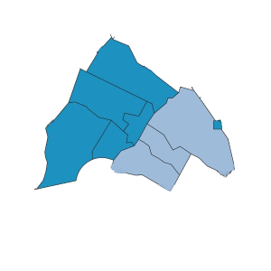
PHL’s Base Figure
Based on projected opportunities and past/current DBE participation, PHL estimates that 80% of DBEs are in the 7-county Philadelphia region compared to all firms that can participate in PHL’s FAA-funded contracts.
In 7-county area
Listed in PA UCP, NJ UCP Directory, OEO directory
In relevant NAICS codes
DBEs
In 7-county area
From US Census County Business Patterns data
In relevant NAICS codes
All Firms

Slide 12
PHL’s Base Figure
Relevant (not all) Construction Related NAICS Codes
NAICS Code | Description
236220 | Commercial and Institutional Building Construction
237110 | Water and Sewer Line and Related Structures Construction
237130 | Power and Communication Line and Related Structures Construction
237310 | Highway, Street, and Bridge Construction
237990 | Other Heavy and Civil Engineering Construction
238110 | Poured Concrete Foundation and Structure Contractors
238120 | Structural Steel and Precast Concrete Contractors
238130 | Framing Contractors
238150 | Glass and Glazing Contractors
NAICS Code | Description
238160 | Roofing Contractors
238190 | Other Foundation, Structure, and Building Exterior Contractors
238210 | Electrical Contractors and Other Wiring Installation Contractors
238220 | Plumbing, Heating, and Air-Conditioning Contractors
238310 | Drywall and Insulation Contractors
238320 | Painting and Wall Covering Contractors
238340 | Tile and Terrazzo Contractors
238350 | Finish Carpentry Contractors
238910 | Site Preparation Contractors
238990 | All Other Specialty Trade Contractors
Note: Census updated some NAICS codes in 2022 – Source for the comparison - https://www.naics.com/2022-naics-changes/

Slide 13
PHL’s Base Figure
Relevant Engineering/Design/Construction Management Related NAICS Codes
NAICS Code | Description
541310 | Architectural Services
541320 | Landscape architectural services
541330 | Engineering Services
541340 | Drafting services
541360 | Geophysical Surveying and Mapping Services
541370 | Surveying and Mapping (except Geophysical) Services
541611 | Administrative Management and General Management Consulting Services
541618 | Other Management Consulting Services
541620 | Environmental Consulting Services
541690 | Other Scientific and Technical Consulting Services
541990 | All Other Professional, Scientific, and Technical Services
561410 | Document preparation services

Slide 14
PHL’s Base Figure
Calculate Step 1 Results
Project | Number of Available DBEs | Number of All Firms | Relative Availability
Construction / Construction Related Services | 1061 | 12244 | 8.67%
Engineering/Design/Construction Management Services | 454 | 4,544 | 9.99%
Combined Totals | 1,515 | 16,788 | 9.02% | Overall Availability of DBEs
Project | Weight* | x | Availability | Weighted Base Figure
Construction / Construction Related Services | 90% | x | 8.67% | 7.80%
Engineering/Design/Construction Management Services | 10% | x | 9.99% | 1.00%
 |  |  | Total | 8.80%

Slide 15
Adjusting PHL’s Base Figure
After Step 1, determine what adjustment, if any, is needed to the base figure. Consider:
Past DBE participation
Evidence from disparity studies
Any available evidence from related fields that affect the opportunities for DBEs to form, grow and compete

Slide 16
Adjusting PHL’s Base Figure
Past participation of DBEs was determined to be the only relevant adjustment to consider.
For the current goal, past participation used was:
Fiscal Year | DBE Goal | Goal Attainment
2022 | 17.93% | 16.61%
2023 | 18.80% | 10.77%
2024 | 18.80% | 11.84%
 | MEDIAN | 11.84%
Regulations require using the median (or middle) past participation percentage

Slide 17
Adjusting PHL’s Base Figure
  Calculate the Overall Goal by averaging the results of Step 1 (8.80%) with Step 2 (11.84%)
8.80%
11.84%
10.32%
2
Proposed goal of 10.32% will be obtained using race-neutral means (1%) and using race-conscious means (9.32%).

Slide 18
Public Participation
PHL is required to communicate with the public in two ways for DBE goal-setting:
  Consultative process with stakeholders (today)
  Publishing of goals on its website
Please ask us your questions now or send comments on the goal and / or methodology by 7/29/2025 to:
  ktighe@miconsult.net
  and
  deneen.wilson@phl.org

Slide 19
Discussion/Questions

Slide 20
Thank You!
Donna Jackson Stephans, VP of Aviation
DBE contact: Deneen Wilson deneen.wilson@phl.org

